Slide 1

PRICE
AWARE
City Travel Fare Guide

Slide 2
1
PROBLEM STATEMENT
Visitors visiting India or people in different states of India often fall victim to scams due to a lack of knowledge about the original prices of goods, services, and local attractions. Whether it's being overcharged by taxi drivers, paying inflated prices for souvenirs, or being misled about the cost of tours, these experiences can tarnish the travel experience and lead to significant financial losses. The absence of a reliable source for accurate pricing information makes it difficult for visitors to know when they are being overcharged.

Slide 3
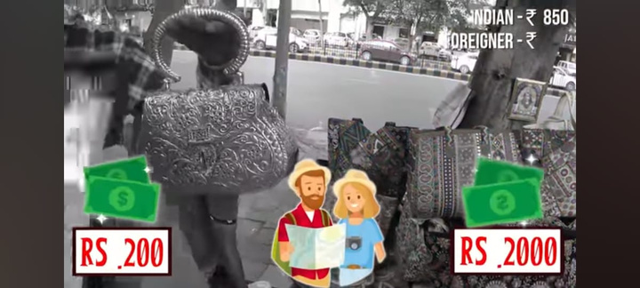
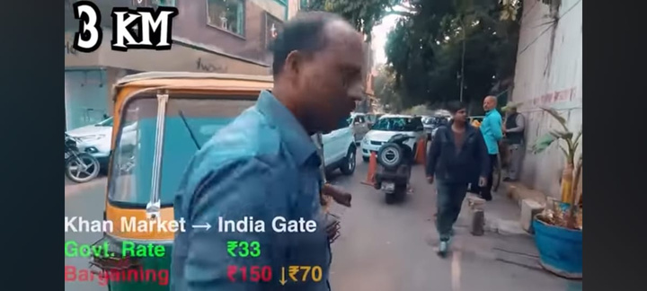
2
SCAMS
False price convincing power
Auto Driver Scam

Slide 4
3
FEATURES
Price Range Display
Bargaining tips
Review and blogs
Auto fare
Taxi fare
City bus fare
Route Selection
Real-Time Updates

Slide 5
4
TARGET AUDIENCE
REVENUE STREAMS
City Residents (Daily Commuters)
Tourists and Visitors
Students and Working Professionals
Transport and Travel Enthusiasts
Affiliate Marketing
Advertising
Premium Features

Slide 6
5
COMPITITORS
Numbeo
prizedekho.com
Mysmartprice.com
compareraja.com
Above websites mainly gives information about electronics appliances and compares prices with different e-commerce retailers

Slide 7
6
USP
1.Fair local price ranges for transportation.
2. Reviews
3.Specified preference(premium)
4. Notification about price influctuations

Slide 8
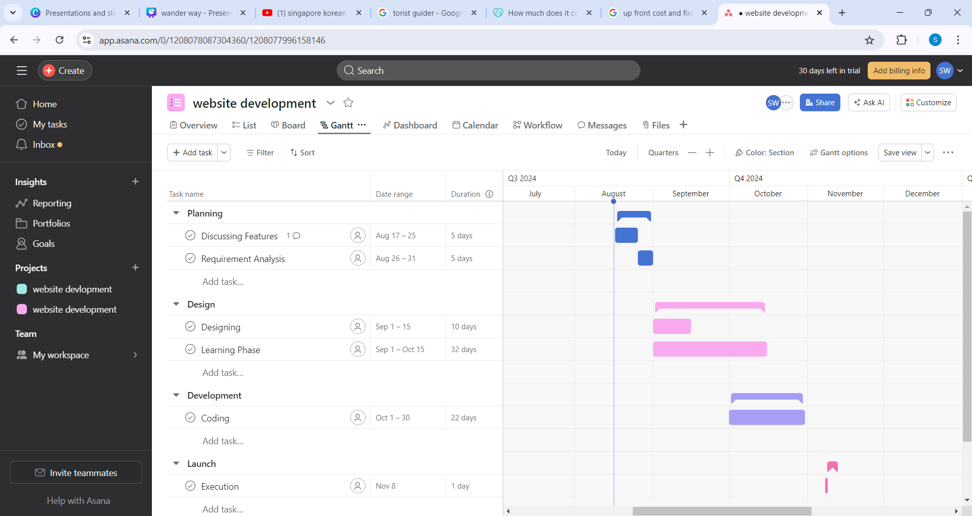
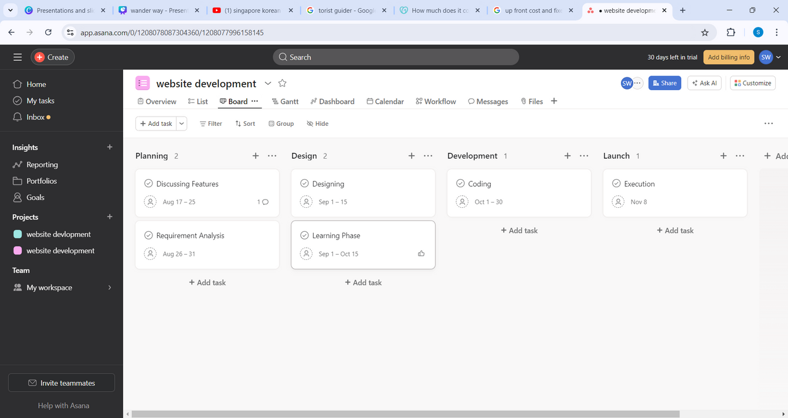
7
TIMELINE

Slide 9
8
BUDGET
Domain name
Maintenance expenses
INR 100- INR 6000 each year
INR 40,000 per month
Web Hosting
SEO
INR 200- INR 500 per month
INR 15,000- INR 30,000 per month
Reference:https://www.godaddy.com/resources/in/skills/cost-to-build-a-website-in-india

Slide 10
THANK YOU
Presented By : Shreya Wallalwar(25)
Tejashwini Patil (09)

